Slide 1
Atlantic Slave Trade

Slide 2
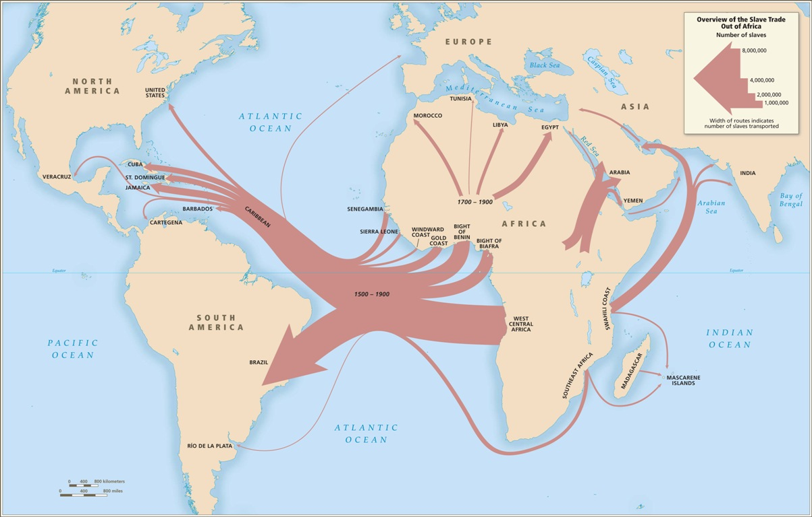

Slide 3
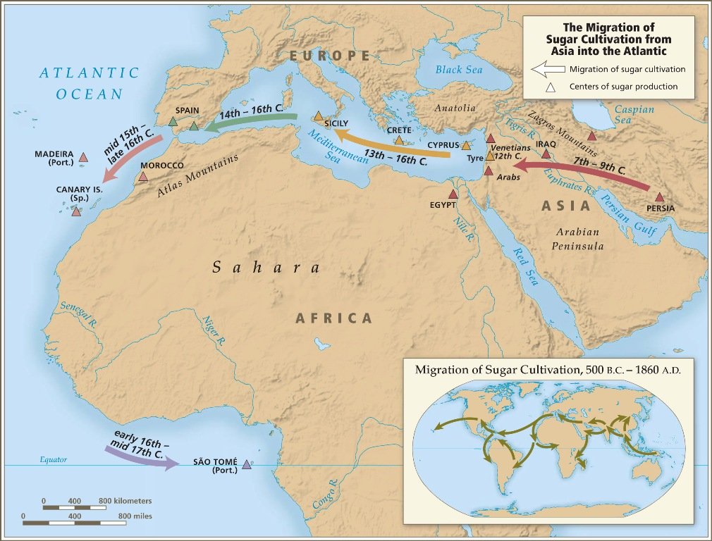

Slide 4
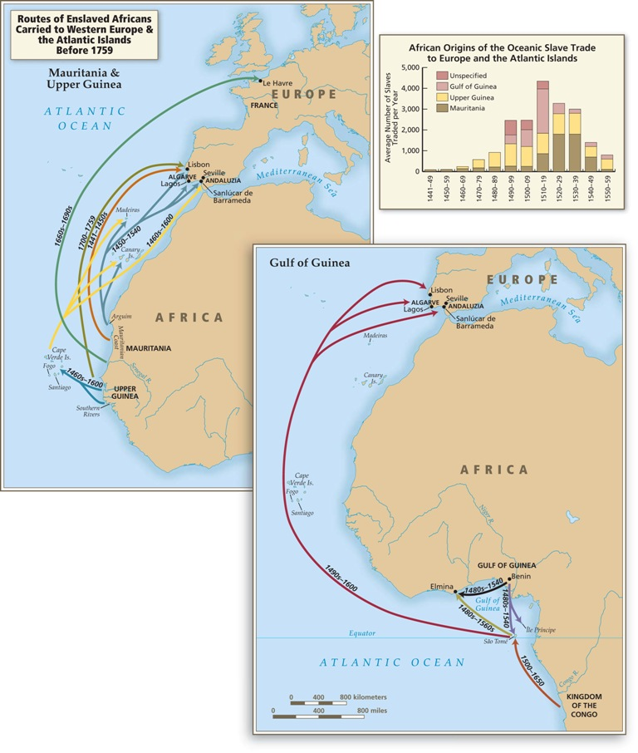

Slide 5
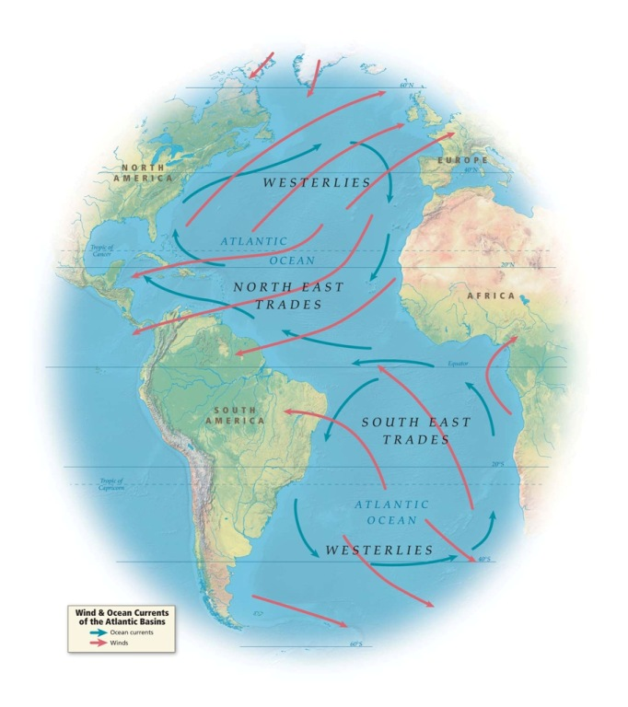

Slide 6
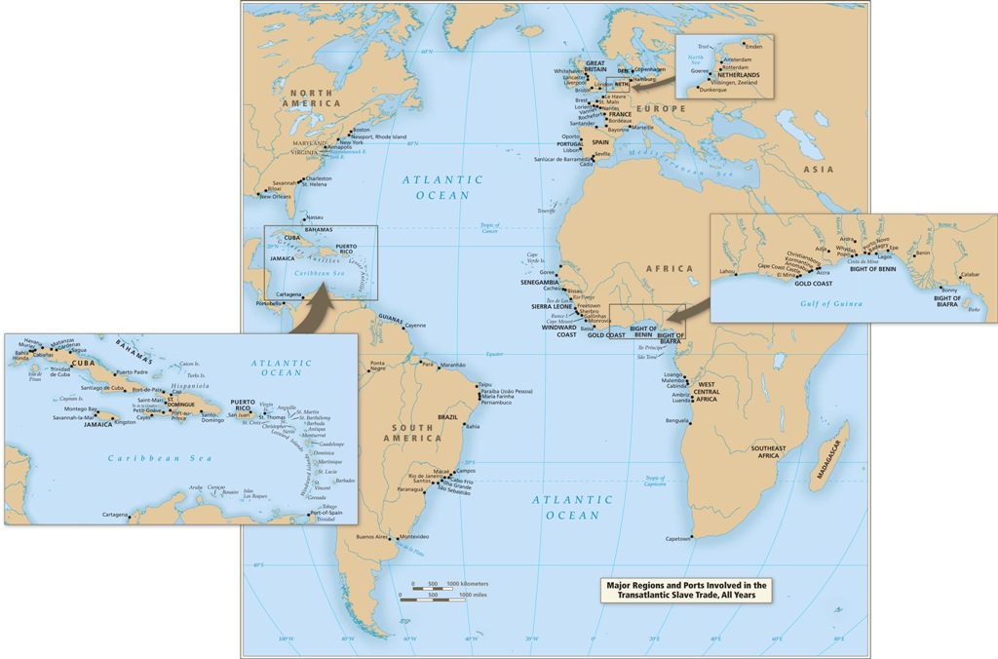

Slide 7
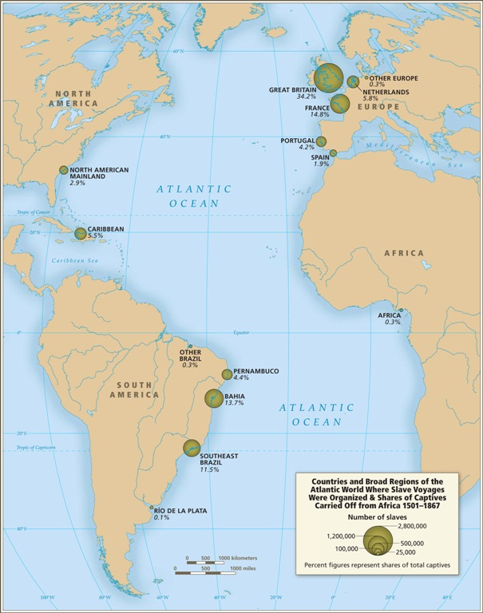

Slide 8
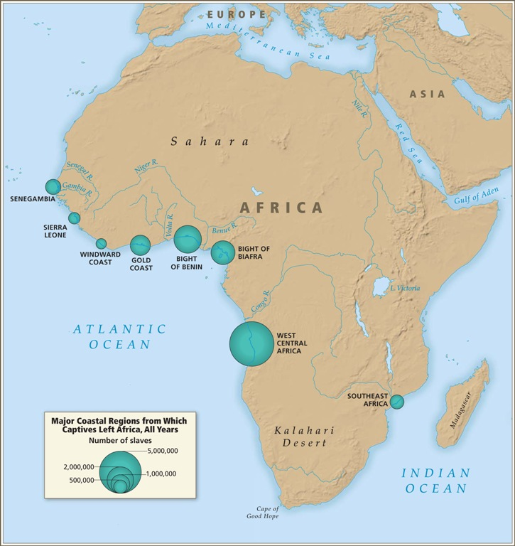

Slide 9
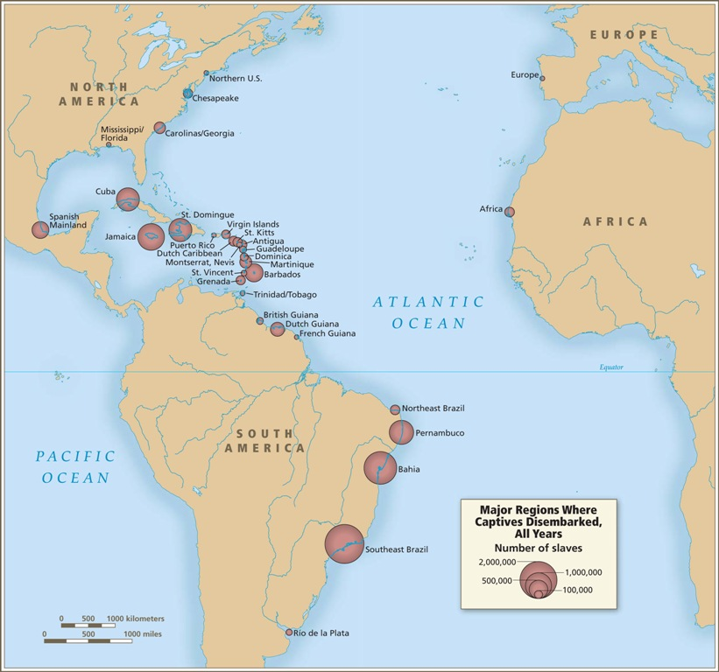

Slide 10
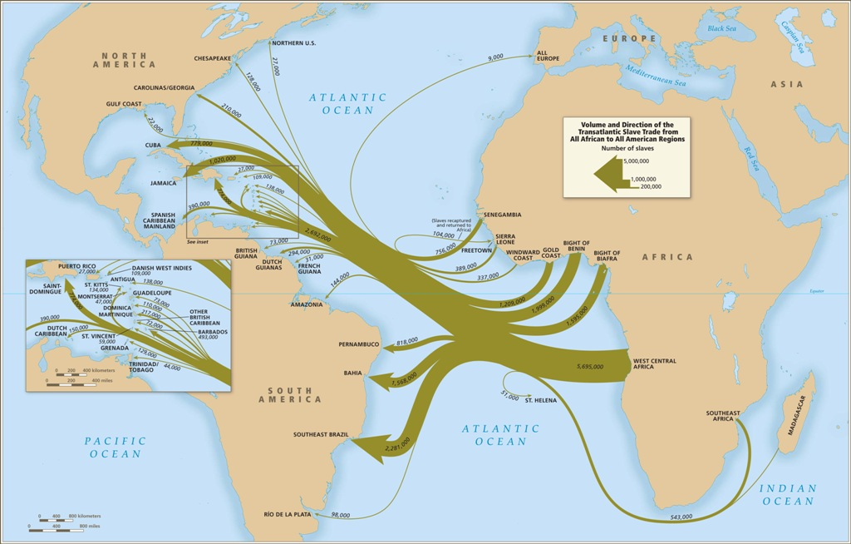

Slide 11
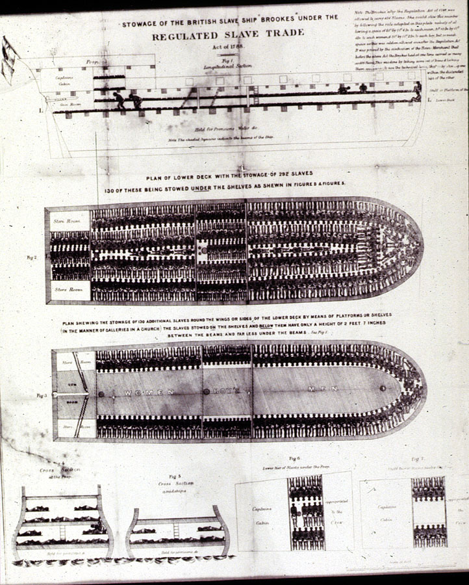
Notes:
Image Reference E014
Source Broadside collection, Rare Book and Special Collections Division, Library of Congress (Portfolio 282-43 [Library of Congress, Prints and Photographs Division, LC-USZ62-44000]; also, Special Collections Department, University of Virginia Library and Library Company of Philadelphia.
Comments "Stowage of the British Slave Ship 'Brookes' under the Regulated Slave Trade, Act of 1788"; shows each deck and cross-sections of decks and "tight packing" of captives. One of the most famous images of the transatlantic slave trade. After the 1788 Regulation Act, the Brookes (also spelled Brooks) was allowed to carry 454 slaves, the approximate number shown in this illustration. However, in four earlier voyages (1781-86), she carried from 609 to 740 slaves so crowding was much worse than shown here; for example, in her 1782 voyage with 609 enslaved Africans, there were 351 men, 127 women, 90 boys, and 41 girls crammed into its decks (thanks to David Eltis for this information). The illustration shown here also appears in Carl B. Wadstrom (An Essay on Colonization, particularly applied to the Western coast of Africa... in Two Parts [London, 1794, 1795], as a fold-out in the pocket attached to cover. Wadstrom includes a very lengthy and detailed description of the Brookes, and notes the illustration was first published in 1789, the "proprietors [of the engraving] favoured him with the original plate" (see image Wad-1 on this website). This illustration of the Brookes, or sections of it, was often reprinted in other contemporary sources dealing with the slave trade, as well as in more modern secondary works. Its most famous reproduction is in Thomas Clarkson, The History of the Rise, Progress, and Accomplishment of the Abolition of the African Slave-Trade by the British Parliament (London, 1808), vol. 2, between pp. 110 and 111; (Philadelphia, 1808), vol. 2, between pp. 90 and 91 (the space calculations that Clarkson reports are from a House of Commons report in 1789). Also published as a separate engraving by Willian Kneass (Philadelphia, 1808; see Library Company of Philadelphia). An excellent and readable account of the history of this image and the role it played in the British abolitionist movement is in Marcus Rediker, The Slave Ship: A Human History (Viking 2007), pp. 308-342.

Slide 12
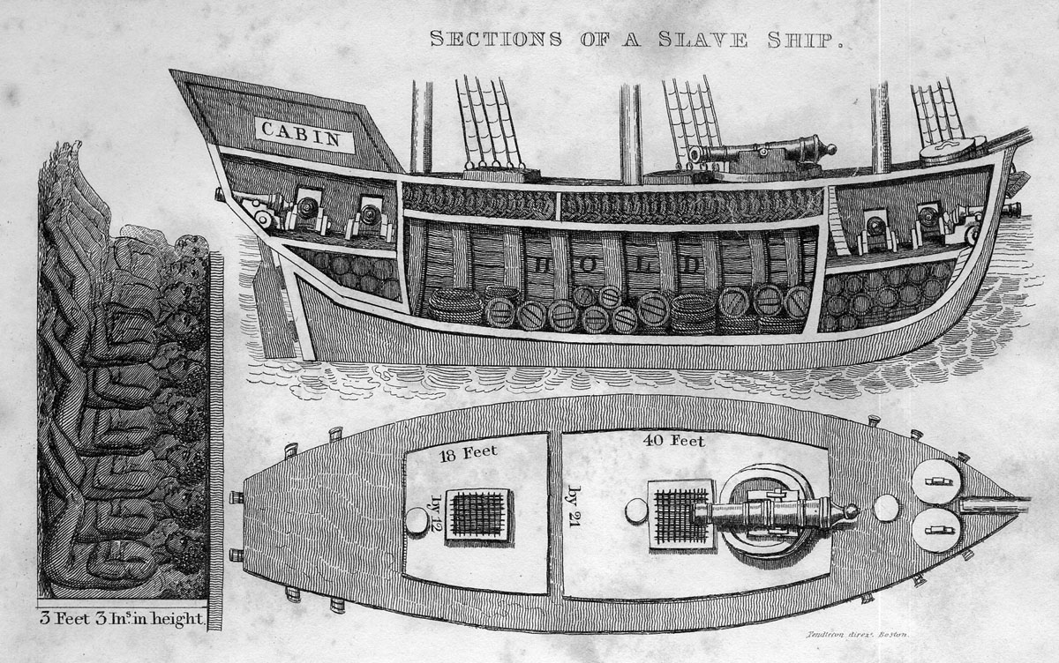
Notes:
Image Reference walsh01
Source Robert Walsh, Notices of Brazil in 1828 and 1829 (Boston and New York, 1831), vol. 2, facing title page.
Comments Caption, "sections of a slave ship"; shows the areas allotted for human cargo as well as non-human cargo. The author's source of information for this drawing is not given. The drawing is also published in Mathew Carey, Reflections on the causes that led to the formation of the Colonization Society (Philadelphia, 1832)

Slide 13
Notes:
Image Reference 2-589a
Source Based on accounts of Jean Barbot, A Description of the Coasts of North and South Guinea and William Smith, A New Voyage to Guinea (1744), In Thomas Astley (ed.), A New General Collection of Voyages and Travels (London, 1745-47), vol. 2, plate 61, facing p. 589. (Copy in Special Collections, University of Virginia Library)
Comments Places identified, from left to right: El Mina, Jago, Cape Corse, Fort Royal at Manfrow, Mowri. In foreground, European slave ships and several canoes, identified by letter A, with caption reading "Negro canoas carrying slaves aboard at Manfro." See Astley, p. 588 ff. for description based on various contemporary accounts; deals with kingdom of Fetu, a coastal Fante-speaking kingdom. See also P.E.H. Hair, Adam Jones, and Robin Law, Barbot on Guinea [1678-1712] (London, 1992), vol. 2, p. 518 and fig. 45. With respect to this illustration, Barbot reports: "These Moorish merchants do not trade only in gold but also in slaves, whom they bring to the ships in fairly large numbers when there are wars . . . . You can see in this drawing a canoe containing slaves who are to board a vessel, and other canoes arriving to trade in gold" (ibid., p. 518). See also image reference LCP-54 on this website.

Slide 14
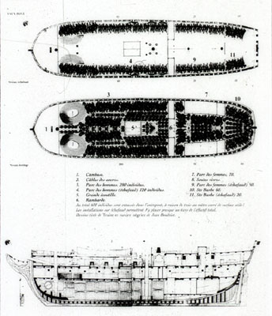
Notes:
Image Reference E013
Source Published in the exhibition catalog Les Anneaux de la Memoire: Nantes-Europe-Afriques-Ameriques, Chateau des Ducs de Bretagne, Nantes, France, Dec. 1992-Feb. 1994. See comments for original source.
Comments Artist's reconstruction of decks aboard the Aurore, which sailed from La Rochelle in 1784, picked up about 500 Africans from north of the Congo River, and sold its captives in Saint Domingue. The illustration shows tight packing of captives and storage areas. This illustration was apparently produced expressly for the exhibition in Nantes, and was done by Jean Boudriot; it is a composite of two of his earlier drawings which were first published in his Traite et Navire Negrier lAurore (Paris: published by author, 1984), pp. 38-39, 46-47. David Moore helped in the identification of this source

Slide 15
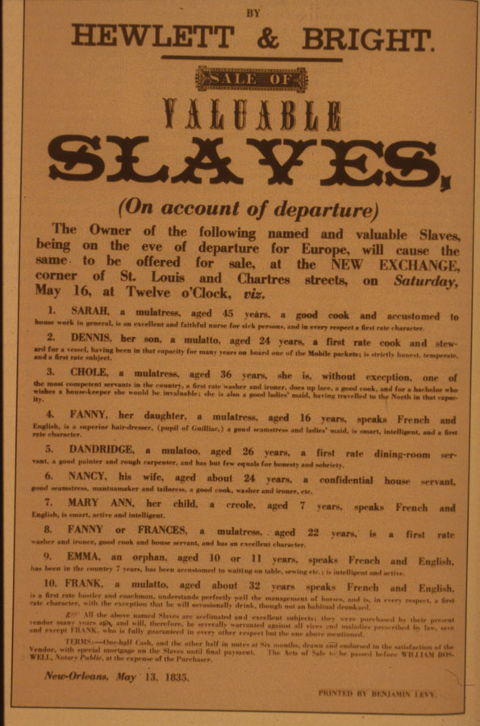
Notes:
Image Reference 79a_slave_sale
Source Collection of the New York Historical Society, # 46628; published in E.D.C. Campbell and K.S. Rice, eds., Before Freedom Came: African-American Life in the Antebellum South (Univ. Press of Virginia, 1991), fig. 100, p. 116.
Comments Broadside advertising sale of 10 slaves, giving their names and personal attributes. Slaves are being sold because of owner's departure from New Orleans. (Permission to display on website, courtesy of the New York Historical Society.)

Slide 16
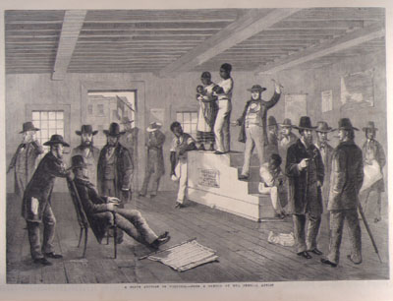
Notes:
Image Reference auction_Richd_1861
Source The Illustrated London News (Feb. 16, 1861), vol. 38, p.139. (Copy in Special Collections Department, University of Virginia Library)
Comments Shows a man and woman (with child in arms) on auction block, surrounded by white men. Article in the ILN accompanying this "sketch by our special correspondent" (G.H. Andrews) provides a lengthy eyewitness description of slave sales in Richmond, part of which is excerpted here: "The auction rooms for the sale of Negroes are situated in the main streets, and are generally the ground floors of the building; the entrance-door opens straight into the street, and the sale room is similar to any other auction room . . . . placards, advertisements, and notices as to the business carried on are dispensed with, the only indications of the trade being a small red flag hanging from the front door post, and a piece of paper upon which is written . . . this simple announcement--'Negroes for sale at auction' . . . ." From here there follows a detailed description of the scene shown in the illustration and the auction process (pp. 138 -140). A composite engraving, combining the auction block and people on the right shown in this image with the image of a slave being inspected for sale (see image NW0027) was published in the French publication L'illustration, Journal Universel (vol. 37 [1861], p. 148), misleadingly giving the impression that the scene is an original depiction of a slave sale in South Carolina; this illustration, in turn, appears on the Mary Evans Picture Library website with an unattributed source (picture no. 10044451).

Slide 17
Narrative of the Life of Frederick Douglass
Written by Himself

Slide 18
Narrative of the Life of Frederick Douglass
200 slave narratives
published 1845 , 5000 copies sold out in four months, 4 more editions of 2000 each, within five years 30,000 copies, 1 year after circulation 1 million readers
the popularity of the slave narrative vs. the plantation novel (at least 14 after HBS in 1852)
the popularity of the slave narratives are transatlantic and international, Britain, Scotland and Ireland
the eloquence and rhetoric of the Narrative astounded readers, could not believe it was really the narrative of a slave (compare effect of jazz in Europe during WWI)

Slide 19
Narrative of the Life of Frederick Douglass
sentimental novel and the picaresque
the picaresque (the confessional of a fugitive, the revision of a life, not just testimonial)
both the pícaro and the exslave are outsiders, orphans - stress on the material level of existence, profusion of objects, and parody of social institutions
the sentimental novel on the other hand, florid, piety, rhetoric, melodrama, abuse of women, punish, rags to riches
grafting together conventions of two of the most popular genres of the period for political effect

Slide 20
Narrative of the Life of Frederick Douglass
sublime narrative, in the first person, a ready vehicle for ideas
¨irony of seeming innocence¨
romanticism in American, an expression of the self, language as a ¨necessary but unfortunate instrument¨ (Gates Binary)
the narratives – the freedom of the self fashioned after the slave frees himself and writes the narrative,
identity as property and object to human being and subject
¨personal experience with titanic nature¨ - the sublime in the flight through the wilderness – the imposition of the (fugitive) self on nature
¨the writer and the subject merge into the stream of language¨
as opposed to the 19th century artistic novel that embraces ambiguity and posits the ¨metaphysical necessity of evil¨ (Melville) the narratives are based on a tyrannical binary, antitheses ¨Binary Oppositions¨ p. 89

Slide 21
Narrative of the Life of Frederick Douglass
¨But the writing of blacks had, since the European Renaissance and the Enlightenment, always assumed larger ideological and social implications than the mere rendering of a life. Perhaps the most remarkable aspect of the Englightenment is that, by the middle of the eighteenth century, ethnocentrism and logocentrism had been forged together into on irresistible weapon drawn upon to justify the enslavement of the African. The absence and presence of writing, of a collective black voice that could in some sense be overheard, were drawn upon by European philosophers to deprive African slaves of their humanity.¨ Gates ¨Language of the Self¨ 104

Slide 22
Narrative of the Life of Frederick Douglass
Hartman and Aunt Hester´s Scream.
¨Hartman tries but cannot make disappear the originary performance of the violent subjection of the slave´s body.¨ (4)
¨The history of blackness is testament to the fact that objects can and do resist. Blackness – the extended movement of a specific upheaval, an ongoing irruption that anarranges every line – is a strain that pressures the assumption of the equivalence of personhood and subjectivity. While subjectivity is defined by the subject´s possession of itself and its objects, it is troubled by a dispossessive force objects exert such that the subject seems to be possessed – infused, deformed – by the object it possesses.¨ In the Break (1)

Slide 23
Narrative of the Life of Frederick Douglass
Hartman
natal alienation, lose your mother,
impossibility to dwell, the breach of the middle passage,
the origin which is quite literally an absence, a tomb/womb,
the originary as the impossibility to mark an origin, the originary is the absence of continuity with a defaced, exterminated origin,
in the middle passage, and in the structure of the family under slavery. The sin of Ham is to look upon his origin.
The sexual cut

Slide 24
Narrative of the Life of Frederick Douglass
written to prove his status as fugitive rather than free, Garrison did not want analysis
Angela Davis – subjective and objective freedom, freedom of thought and freedom of action
Valerie Smith Self Invention and Authority in Afro American Narrative
Writing or literacy is not the only mode of the making of the slave into a human but in fact the lesser. The slave narrative are in generally rigidily formulaic, but Equiano and Douglass´s and Harriet Wilson´s break with the conventions and present a different and more radical vision. In Douglass, the stylistic novelties are the level of interpretation, the inclusion of sexual violence to shock the morals and its sheer rhetorical force. (Chapter 1)
the images of animals, blood, ship and sails circulate 20

