Slide 1
Introduction to Thermodynamics
INTD 3990: Alternative and Appropriate Technologies
November 10, 2016

Slide 2
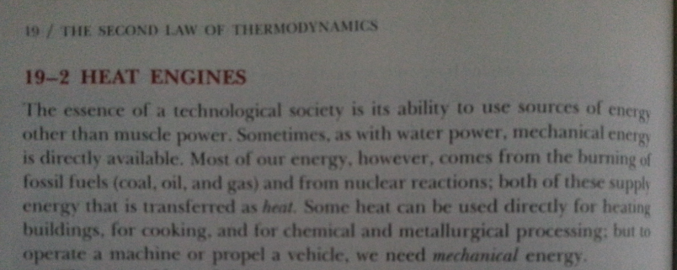
A thought
“The essence of a technological society is its ability to use sources of energy other than muscle power.”

Slide 3
Thermodynamics
Thermodynamics is the study of conversion between heat and work.
Heat is understood as the flow of thermal energy from one body to another
Work is understood mechanically as the change of energy of a system caused by moving a force through a distance (W = Fd)

Slide 4
Equivalence of Heat and Work
W = Fd

Slide 5
Working Substances
Thermodynamic processes liberate or extract energy by exploiting properties of substances, including phase changes. This includes many processes that are based on ideal gasses.
Ideal Gas Law: pV = nRT
Note: mathematically similar to zx = ky

Slide 6
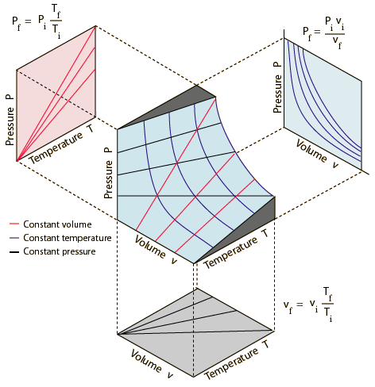
Ideal Gas Law: Surfaces and Curves
pV = nRT
Notes:
REF: http://web.inc.bme.hu/csonka/csg/oktat/english/gaslaws_elemei/image001.gif

Slide 7
Phase Diagrams for Real Substances
p

Slide 8
Ideal vs. Real
p

Slide 9
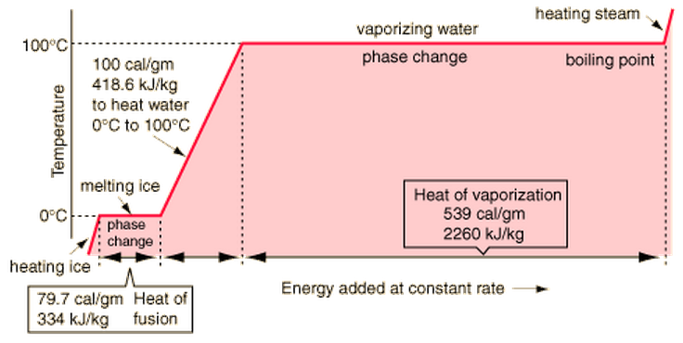
Ex: Phase Changes in Water
0.477 cal/g
1.996 kJ/kg
1 cal/g
4.184 kJ/kg
0.504 cal/g
2.108 kJ/kg
Notes:
http://hyperphysics.phy-astr.gsu.edu/hbase/thermo/imgheat/pha1.gif
http://answers.yahoo.com/question/index?qid=20070625090803AAz5a8u

Slide 10
Expansion of Volume → Work
$$W=\int_{x1}^{x2}{pA dx} =\int_{V1}^{V2}{p dV}$$

Slide 11
1st Law of Thermodynamics
-Q_{out}←
→ W
ΔU
Q_{in} →
Q_{in} + Q_{out} = ΔU + W
Net heat input = change of + work done by
to system internal energy system on
surroundings

Slide 12
Abstraction: Heat Engine
-Q_{out} ←
ΔU
→ W
Q_{in} →
Q_{net} = ΔU + W
Heat “falls” from high temperature “reservoir” to low temperature “reservoir”, allowing work to be done in the process.

Slide 13
2nd Law of Thermodynamics
“It is impossible for any system to undergo a process in which it absorbs heat from a reservoir at a single temperature and converts it completely into mechanical work, while ending at the same state that it began” (SZY 1987, p. 433).
Maximum Theoretical Efficiency (Carnot):

Slide 14
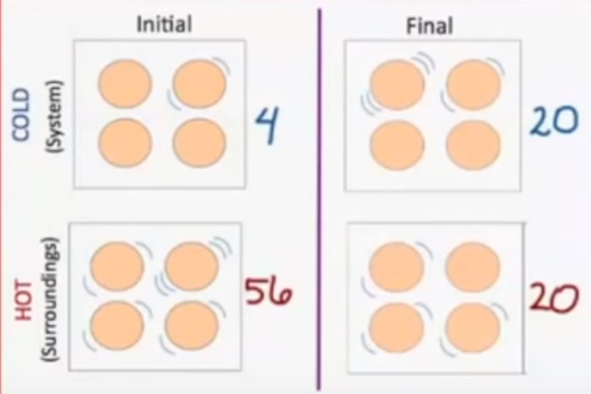
2nd Law of Thermodynamics & Entropy
Heat flows spontaneously from a hot to cold source
Nature favors the state of greatest probability. In the example given, but not shown in the video, the total number of possible microstates of 6 quanta of energy distributed over 8 particles is 1,716. Here the INITIAL and FINAL states represent two possibilities of distribution. There are 224 possible microstates in the INITIAL case and 400 possible microstates in the FINAL case. Therefore, the FINAL case is more favorable.
(4)(56) = 224
(20)(20) = 400
Entropy is a measure of the total number of ways that energy can be distributed in a system. This example shows that there are more ways to distribute the energy when the system is at equilibrium than when it is divided into two different sub-states. So, nature favors heat transfer from hot to cold because that leads to more microstates, and thus greater entropy. Flow from cold to hot would reduce the number of microstates (try counting!). Another way to say this is that we need to supply energy to maintain the distinct systems, whereas the equilibrium state is naturally favored. Finally,
Notes:
REF: https://youtu.be/870y6GUKbwc. At 3:30: “Entropy is a measure of the total number of ways that energy can be distributed in a system”. Screen shot from 10:51.

Slide 15
2nd Law of Thermodynamics
Equivalence of the previous statements: flow from hot to cold is equivalent to not being able to transform all heat into work.
Notice that there is still another way to say this: “you cannot cool a body (which means to transfer heat from cold to hot) without the input of mechanical work”.
Notes:
REF: Sears, Zemansky, and Young, 1987, p. 434.

Slide 16
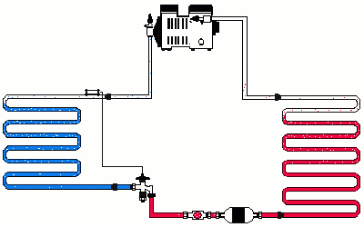
Refrigerators
Q_{C}
Q_{H}
Notes:
http://hvacwebtech.com/images/3SAnim11.GIF

Slide 17
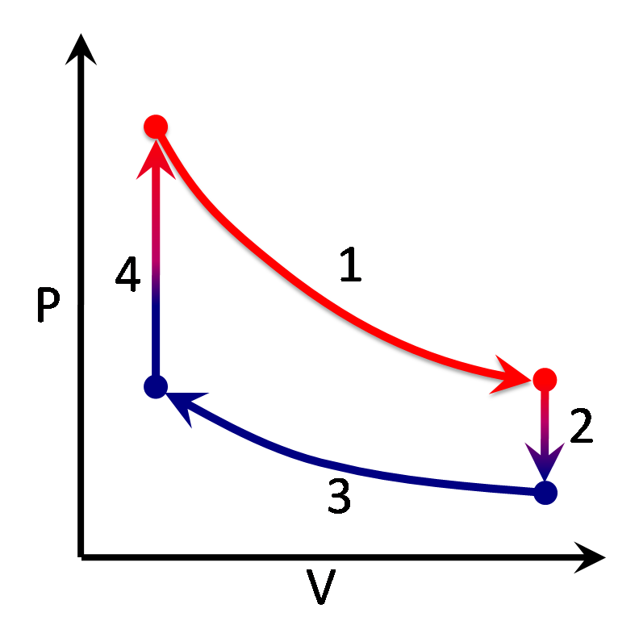
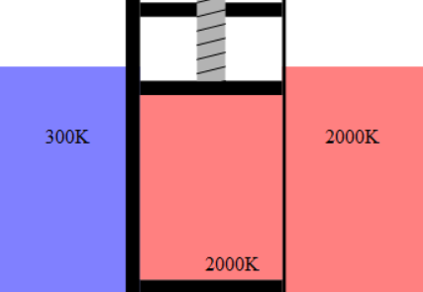
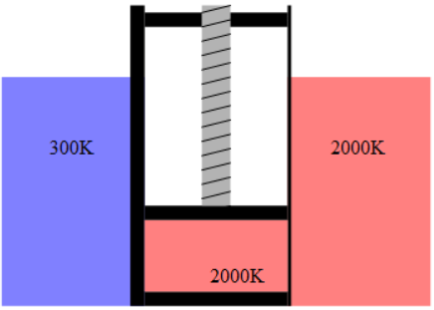
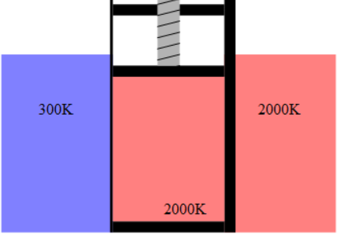
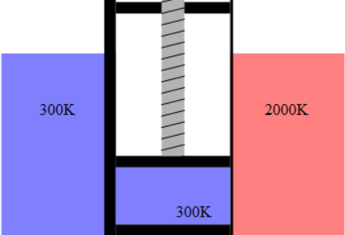
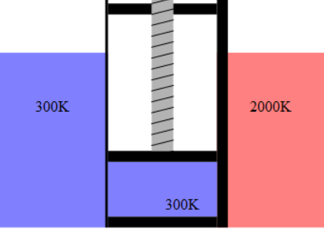
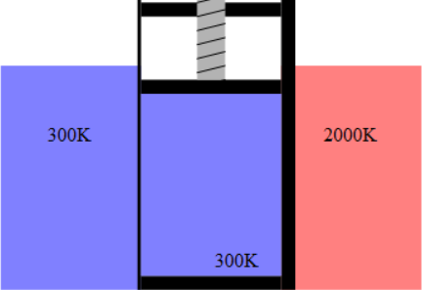
Application: Stirling Engine
p
p₂
T₂
p₁
p₃
T₁
p₄
V₁
V₂
Notes:
http://hvacwebtech.com/images/3SAnim11.GIF

Slide 18
Application: Stirling Engine
p
V₁
V₂
p₂
Q₂₃ = nRT₂ ln(V₂/V₁)
Q₁₂ = nC_{v}ΔT
p₁
p₃
Q₃₄ = nC_{v}ΔT
p₄
Q₄₁ = nRT₁ ln(V₁/V₂)
Notes:
http://hvacwebtech.com/images/3SAnim11.GIF

Slide 19
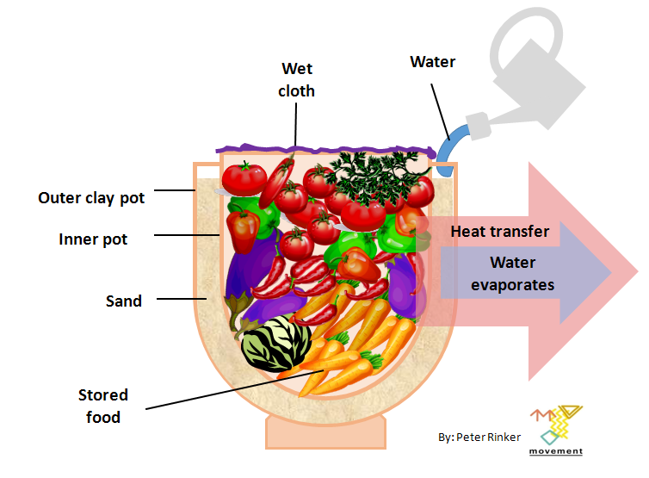
Application: Zeer Pot
Why does evaporation cool? The molecules of water have a distribution of warmer and colder. The warmer molecules near the surface are able to change phase and become vapor, escaping into the atmosphere. This leaves behind the lower-temperature molecules, leading to lower overall temperature.
convection
Conduction
& porosity
Notes:
https://upload.wikimedia.org/wikipedia/commons/4/45/Clay_pot_cooler_-_Canari_Frigo_-_Tonkrugk%C3%BChler.PNG
https://en.wikipedia.org/wiki/Pot-in-pot_refrigerator

Slide 20
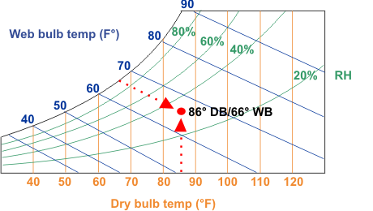
Theoretical Limit of Evaporative Cooler
19ºC
30ºC
Notes:
http://www.wescorhvac.com/Evaporative%20cooling%20white%20paper.htm

