Slide 1
Technical Exercise 2 (40 pts.)
INTD 3990: Alternative and Appropriate Technologies
Due Thursday December 8, 2016
To be completed in assigned groups.

Slide 2
Question 1 (10 pts.)
Consider the following comment that appear on page 5 of “Earthbag Building in the Humid Tropics”:
“Round building walls use less material and labor for the same interior space”.
Explain this comment using simple geometric reasoning. For example, compare a round and square room of the same area – which requires more wall material to enclose the room?
Do you have any criticisms of what is being implied? If round forms are superior, why do we see relatively few of them?

Slide 3
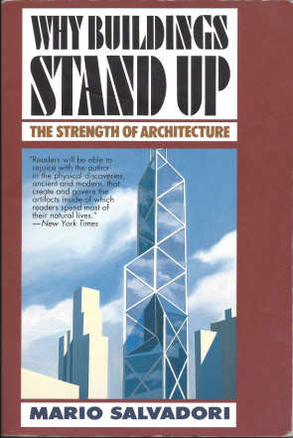
Question 2 (10 pts.)
Build the models from Figures 11.20 and 11.21 from Salvadori’s book (see next slide).
Based on your experiment, which holds more weight? Can you explain why?
Submit your folded papers with your assignment. Include photos if possible.

Slide 4
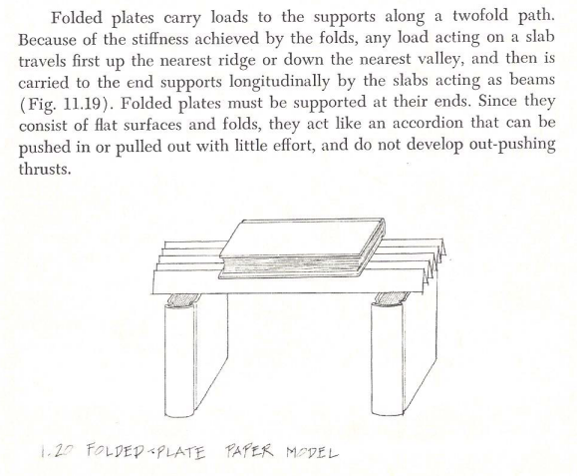
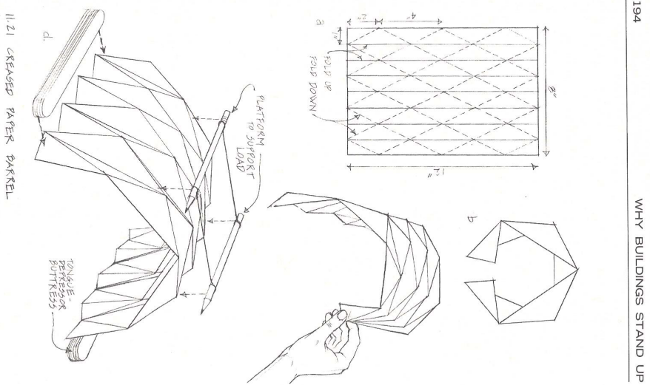
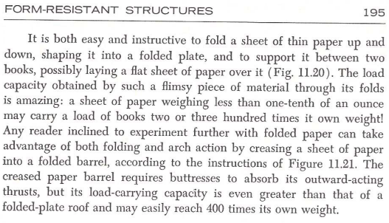
Question 2 (continued)

Slide 5
Question 3 (10 pts.)
Consider the structural forms introduced in “Introduction to Structural Behavior”: columns, beams, slabs, cables, arches, and domes.
Find at least one example of each form from structures that you encounter yourself (do NOT take photos from the web). Identify the structure, its location, and its material (guess if necessary). Write a brief explanation of why you think that the given structural element is (or maybe is not) useful or applicable.

Slide 6
Question 4 (10 pts.)
Suppose you buy a fountain soda and then throw out the ice after you are finished.
Estimate the mass of a typical amount of ice in a cup.
Estimate the amount of energy that you are wasting. Hint: consult the phase-change diagram of water in the “Introduction to Thermodynamics” presentation and estimate the latent heat required for melting from solid to liquid.
If you wanted to save the ice, how much useful work could you expect to produce, and how might you do this? Would it be worth the effort?

