Slide 1
Introduction to Energy and Power
INTD 3990: Alternative and Appropriate Technologies

Slide 2
Energy
Energy is the capacity to do work.
Work can transfer energy from one system to another and/or transform/convert energy from one form to another.
Energy has the same units as work and heat. Later we will see that heat (low quality energy) is always generated when energy is converted from one form to another.
These ideas will become more clear with examples in this class AND your critical thinking about the answers you obtain to problems in other courses such as physics, chemistry, mechanics, and thermodynamics.

Slide 3
Energy
Energy is a measure of the distance that a system is away from equilibrium.
Energy can be derived from systems in which there is a difference in state between two neighboring regions.
Energy can make things “flow up hill”
Energy “let’s you do stuff”/make a difference or change

Slide 4
Power
Recall: Energy is the capacity to do work.
Power is the rate of energy use, exertion, production, or consumption with respect to time.
Recall that a unit of energy is the Joule (1J = 1 Nm). A standard unit of power is the Watt, and is defined as 1 Joule/second: 1 Watt = 1 J/s

Slide 5
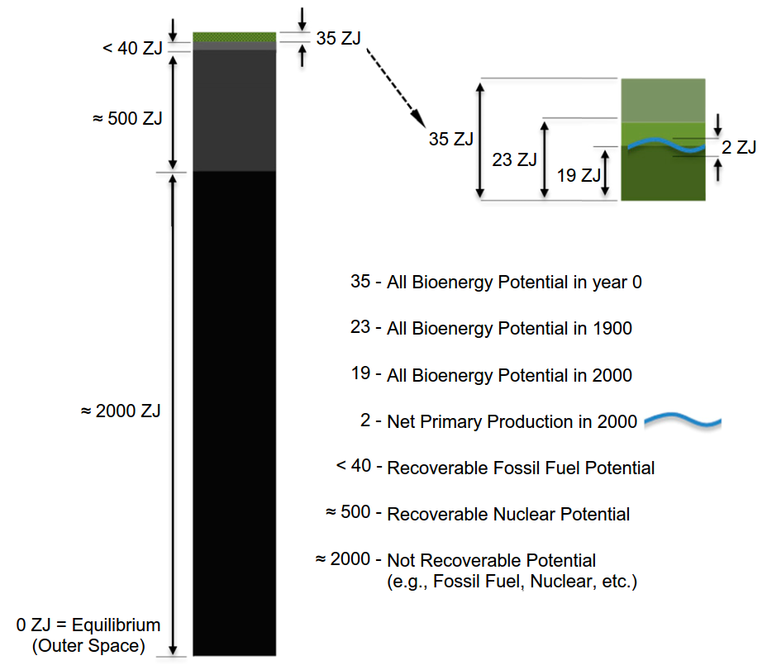
Fig. 2 from Schramski et al.

Slide 6
Key Aspects of Energy
Energy …
Generation
Storage
Transmission
Use/Consumption

Slide 7
Key Insight
Notice that human “needs” require devices to capture, store, transmit, and convert energy into “useful” forms.

Slide 8
Efficiency
Efficiency can be though of as a ratio of how much “useful” or “purposeful” energy is used vs. how much total energy is used. For example, we could examine specific processes, such as:
What is the theoretical minimum vs actual (e.g. walking, biking, or driving) amount of energy required to ascend a hill at constant speed?
What is the theoretical minimum vs actual (e.g., using a microwave) amount of energy required to heat a plate of food from 36ºF (refrigerated) to 160ºF (cooked)?

Slide 9
A Related Question
Can you explain why a person can go faster using a bicycle or skateboard rather than by walking?

Slide 10
US Energy Flowgram (2014)
0.102 ZJ equivalent

Slide 11
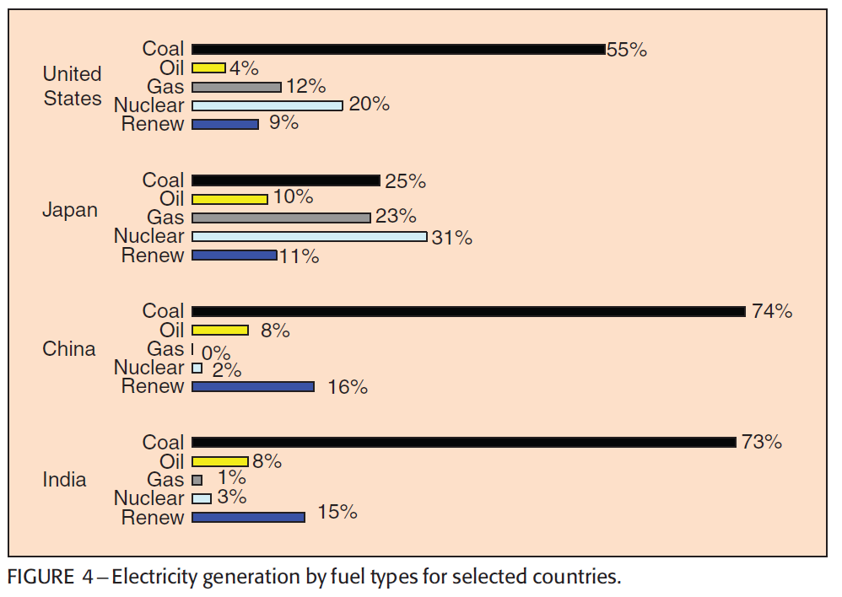
Country Comparison of Energy Sources
Source: B.K. Bose, “Global Warming: Energy, Environmental Pollution, and the Impact of Power Electronics”,
IEEE Industrial Electronics Magazine, vol. 4, no. 1, pp. 6-17, March 2010.
Notes:
2 minuts

Slide 12
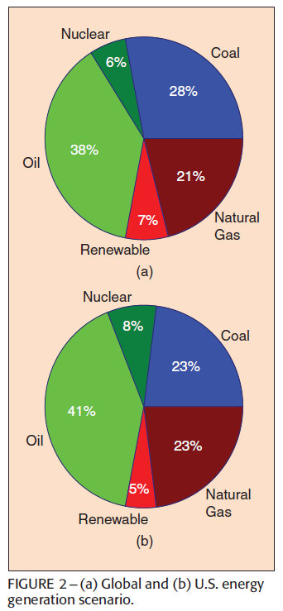
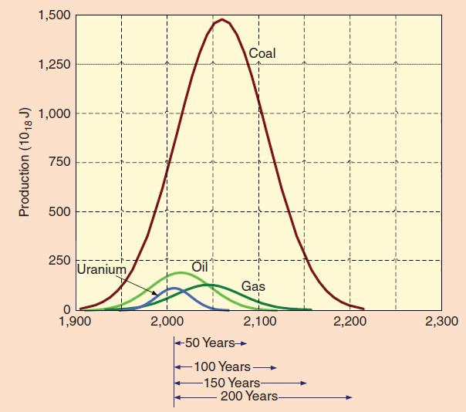
Limits
Source: B.K. Bose, “Global Warming: Energy, Environmental Pollution, and the Impact of Power Electronics”,
IEEE Industrial Electronics Magazine, vol. 4, no. 1, pp. 6-17, March 2010.
Notes:
5 minutes – 25 total

Slide 13
Some Important Notes
Key environmental threshholds will be crossed before energy sources are depleted, e.g., “Keep it in the ground” https://www.theguardian.com/environment/keep-it-in-the-ground-blog/2015/mar/25/what-numbers-tell-about-how-much-fossil-fuel-reserves-cant-burn; 350.org
Institute for Energy and Environmental Research (ieer.org) argues that nuclear energy is not feasible to meet sustainability goals on the timescale of decades
Carbon-Free, Nuclear Free
Research:
US Clean Power Plan
The ___________ Agreement

Slide 14
Some Important Notes
More on nuclear
http://www.transatomicpower.com/
https://www.technologyreview.com/s/512321/safer-nuclear-power-at-half-the-price/ 2013
https://www.technologyreview.com/s/541286/finally-fusion-takes-small-steps-toward-reality/ 2015
https://www.technologyreview.com/s/601388/why-the-worlds-largest-nuclear-fusion-project-may-never-succeed/ 2016

Slide 15
Some More Project Ideas
Do a survey to determine what people understand about energy (can base them off of class questions + others)
Contact representatives from oil companies – perhaps those who come to the UPRM job fair – and ask them what they think about “Keep it in the Ground”
Propose a campus initiative to reduce carbon footprint
Explore some proposals for new energy sources and assess their feasibility

Slide 16
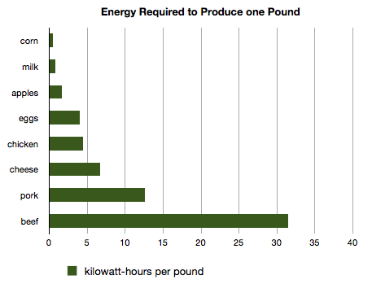
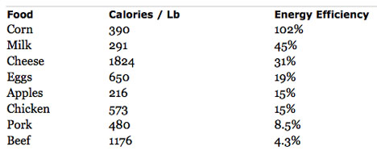
Example: Food Efficiency
http://www.treehugger.com/green-food/energy-required-to-produce-a-pound-of-food.html

