Slide 1
Relations
Chapter 9

Slide 2
Chapter Summary
Relations and Their Properties – Sec 9.1 – Lecture 26
(This Slide)
Equivalence Relations – Sec 9.5 – Lecture 26

Slide 3
Relations and Their Properties
Section 9.1

Slide 4
Section Summary
Relations and Functions
Properties of Relations
Reflexive Relations
Symmetric and Antisymmetric Relations
Transitive Relations
Combining Relations

Slide 5
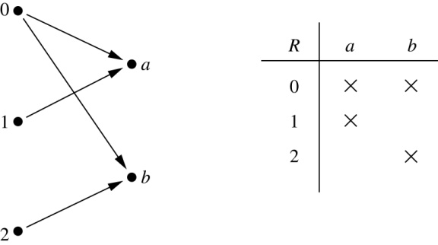
Binary Relations
Definition: A binary relation R from a set A to a set B is a subset R ⊆ A × B.
Example:
Let A = {0,1,2} and B = {a,b}
{(0, a), (0, b), (1,a) , (2, b)} is a relation from A to B.
We can represent relations from a set A to a set B graphically or using a table:
Relations are more general than functions. A function is a relation where exactly one element of B is related to each element of A.

Slide 6
Binary Relation on a Set
Definition: A binary relation R on a set A is a subset of A × A or a relation from A to A.
Example:
Suppose that A = {a,b,c}. Then R = {(a,a),(a,b), (a,c)} is a relation on A.
Let A = {1, 2, 3, 4}. The ordered pairs in the relation R = {(a,b) | a divides b} are
(1,1), (1, 2), (1,3), (1, 4), (2, 2), (2, 4), (3, 3), and (4, 4).

Slide 7
Binary Relation on a Set (cont.)
Question: How many relations are there on a set A?
Solution: Because a relation on A is the same thing as a subset of A ⨉ A, we count the subsets of A × A. Since A × A has n² elements when A has n elements, and a set with m elements has 2^{m} subsets, there are subsets of A × A. Therefore, there are relations on a set A.

Slide 8
Binary Relations on a Set (cont.) (SELF STUDY)
Example: Consider these relations on the set of integers:
R₁ = {(a,b) | a ≤ b}, R₄ = {(a,b) | a = b},
R₂ = {(a,b) | a > b}, R₅ = {(a,b) | a = b + 1},
R₃ = {(a,b) | a = b or a = −b}, R₆ = {(a,b) | a + b ≤ 3}.
Which of these relations contain each of the pairs
(1,1), (1, 2), (2, 1), (1, −1), and (2, 2)?
Solution: Checking the conditions that define each relation, we see that the pair (1,1) is in R₁, R₃, R₄ , and R₆: (1,2) is in R₁ and R₆: (2,1) is in R₂, R₅, and R₆: (1, −1) is in R₂, R₃, and R₆ : (2,2) is in R₁, R₃, and R₄.
Note that these relations are on an infinite set and each of these relations is an infinite set.

Slide 9
Reflexive Relations
Definition: R is reflexive iff (a,a) ∊ R for every element a ∊ A. Written symbolically, R is reflexive if and only if
∀x[x∊U ⟶ (x,x) ∊ R]
Example: The following relations on the integers are reflexive:
R₁ = {(a,b) | a ≤ b},
R₃ = {(a,b) | a = b or a = −b},
R₄ = {(a,b) | a = b}.
The following relations are not reflexive:
R₂ = {(a,b) | a > b} (note that 3 ≯ 3),
R₅ = {(a,b) | a = b + 1} (note that 3 ≠3 + 1),
R₆ = {(a,b) | a + b ≤ 3} (note that 4 + 4 ≰ 3).
If A = ∅ then the empty relation is reflexive vacuously. That is the empty relation on an empty set is reflexive!

Slide 10
Symmetric Relations
Definition: R is symmetric iff (b,a) ∊ R whenever (a,b) ∊ R for all a,b ∊ A. Written symbolically, R is symmetric if and only if
∀x∀y [(x,y) ∊R ⟶ (y,x) ∊ R]
Example: The following relations on the integers are symmetric:
R₃ = {(a,b) | a = b or a = −b},
R₄ = {(a,b) | a = b},
R₆ = {(a,b) | a + b ≤ 3}.
The following are not symmetric:
R₁ = {(a,b) | a ≤ b} (note that 3 ≤ 4, but 4 ≰ 3),
R₂ = {(a,b) | a > b} (note that 4 > 3, but 3 ≯ 4),
R₅ = {(a,b) | a = b + 1} (note that 4 = 3 + 1, but 3 ≠4 + 1).

Slide 11
Transitive Relations
Definition: A relation R on a set A is called transitive if whenever (a,b) ∊ R and (b,c) ∊ R, then (a,c) ∊ R, for all a,b,c ∊ A. Written symbolically, R is transitive if and only if
∀x∀y ∀z[(x,y) ∊R ∧ (y,z) ∊ R ⟶ (x,z) ∊ R ]
Example: The following relations on the integers are transitive:
R₁ = {(a,b) | a ≤ b},
R₂ = {(a,b) | a > b},
R₃ = {(a,b) | a = b or a = −b},
R₄ = {(a,b) | a = b}.
The following are not transitive:
R₅ = {(a,b) | a = b + 1} (note that both (3,2) and (4,3) belong to R₅, but not (3,3)),
R₆ = {(a,b) | a + b ≤ 3} (note that both (2,1) and (1,2) belong to R₆, but not (2,2)).
For every integer, a ≤ b
and b ≤ c, then b ≤ c.

